Slide 1

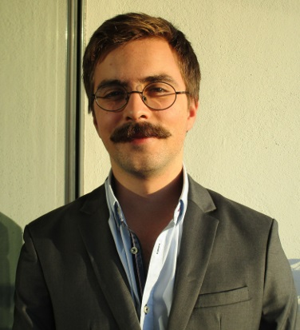














EDUCATION
Bologna Degree in Information Systems and Computer Engineering 2012 – July 2017.
Bachelor of Science
Instituto Superior Técnico Average grade of 13/20.
A-levels
2010 – July 2012
City College Plymouth, UK
Average Grade: B
Subjects: Maths, Physics and Film Studies.
WORK EXPERIENCE
Summer Internee – JULY 2016 – AUGUST 2016
Bridge Robotics – Lisbon
bridgerobotics.com
Worked in frontend development, object-oriented programming in python and javascript, websockets and messaging platforms like RabbitMQ and crossbar.io to test and extend the Bridge Robotics framework.
SKILL / INTERESTS
Frontend Software Developer– September 2016 – Present
opprDev– Lisbon
oppr.io
Oppr is a student created organization whose goal is to find paid work and to share the workload with other like minded students. With opprDev I further developed my frontend programming skills.
HARD SKILLS
JOAQUIM ESTEVES
Date of Birth: 01/09/1993
Nationality: Portuguese
Alameda dos Oceanos nº 95 4ºEsq, Lisboa.
1990 - 213
Portugal
joaquimbve@hotmail.com
+351 91 399 30 37
joaquimesteves.github.io
C
C++
JAVA
SQL
PHP
Python
HTML5/CSS3
JavaScript & JQuery
Languages
Portuguese– Native
English – Full Professional Experience
Spanish – Fluent
French – Basic Use
Driving License B1, B
About Me
I am an adaptable, hard-working graduate seeking an entry-level position in software development, which will utilise the programming and management skills developed through the most renowned computer engineering course available in Portugal.
I am obsessed with old movies, all types of Latino music and traveling.

Slide 2

JOAQUIM ESTEVES
Alameda dos Oceanos nº 95 4ºEsq, Lisboa. 1990 – 213 Portugal
joaquimbve@hotmail.com
+351 91 399 39 37
Dear Hiring Manager,
After being contacted through Linkedin I have been adverted that you are looking for an educated and enthusiastic employee for your company. At this moment I have completed a Bachelor of Science on computer engineering and feel quite ready and excited to position myself on the free job market.
I am particularly looking forward to working under an international company such as Amaris.
I’m excited about the possibility of working abroad, having previously lived abroad in the UK, I can attest to how formative it was to experience a different culture on a day to day basis, I am particularly thankful for the world of literature that was open to me thanks to my further mastery of the English language. I feel like this and other experiences have solidified me as a person that can work in any type of environment with all sorts of co-workers.
I am interested in consulting as I feel like it would be the perfect head start to my career. I possess a varied set of hard skills, which grants me a greater degree of freedom that I feel would be suited to the consulting business.
Ultimately, I feel like my profile and education are well suited for the job and I would gladly complete the first impressions you have of me in a personal interview
Hoping to hear from you soon,

Slide 3
